Slide 1
Session 01 : Introduction To Android
Module 4.3 : Internet Filters

Slide 2
Learning Objectives
At the end of the session successful participants will be able to
Understand Internet filters
Describe parts of a Typical Intent
Implement Example: Intercepting Incoming SMS

Slide 3
Internet Filters
An Analogy: Requesting Actions Using HTTP and Android
The HTTP protocol uses a number of <Action, resource> pairs to accomplish its work.
Some of the HTTP actions are the well known (and lesser known) operations: POST, GET, PUT, DELETE, CONNECT, HEAD, OPTIONS.
Android uses a mechanism quite similar to HTTP for the invocation of work to be done.

Slide 4
Internet Filters
An Analogy: Requesting Actions Using HTTP and Android
INTENT is the Android’s name for the abstraction requesting actions.
Unlike HTTP a given Android’s INTENT could be resolved in more than one potential way (for instance, we may have several SMS apps wanting to process an incoming text‐message).

Slide 5
Internet Filters
Intents
An intent is an abstract description of an operation to be performed.
Its most significant use is in the launching of activities.
The primary pieces of information in an intent are: action & data.

Slide 6
Internet Filters
Intents
Action | Data | Misc
The general action to be performed, such as: ACTION_EDIT, ACTION_VIEW, ACTION_MAN, ACTION_LAUNCHER etc. | The data to operate on, such as a person record in the contacts database, expressed as a URI. I am good for editing a document I am good for viewing a document I am the first exec. Activ. of Application Put me on the phone’s Menu_Pad

Slide 7
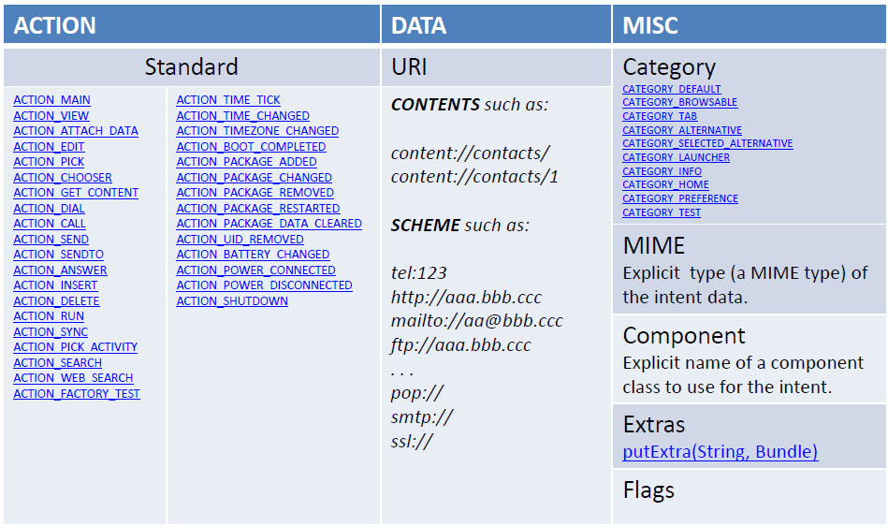
Internet Filters
Parts of a Typical Intent

Slide 8
Internet Filters
Aside: MIME
… This set of documents, collectively called the Multipurpose Internet Mail Extensions, or MIME, redefines the format of messages to allow for…
Textual message bodies in character sets other than
US‐ASCII
An extensible set of different formats for non‐textual
message bodies

Slide 9
Internet Filters
Aside: MIME
… This set of documents, collectively called the Multipurpose Internet Mail Extensions, or MIME, redefines the format of messages to allow for…
Multi‐part message bodies
Textual header information in character sets other than
US‐ASCII

Slide 10
Internet Filters
Aside: MIME
… This set of documents, collectively called the Multipurpose Internet Mail Extensions, or MIME, redefines the format of messages to allow for…
Multi‐part message bodies
Textual header information in character sets other than
US‐ASCII
Note: Current usage of MIME describes content type in general.

Slide 11
Internet Filters
Intent Resolution
When Intents are issued, Android looks for the most appropriated way of responding to the request.
The decision of what to execute is based on how descriptive the call is:
Explicit Intents
Explicit Intents specify a particular component (via setComponent(ComponentName) or setClass(Context, Class)), which provides the exact class to be run. This is a typical way for an application to launch various internal activities it has as the user interacts with the application

Slide 12
Internet Filters
Intent Resolution
When Intents are issued, Android looks for the most appropriated way of responding to the request.
The decision of what to execute is based on how descriptive the call is:
Explicit Intents
Implicit Intents do not specified a particular component. However they include enough information for the system to determine which of the available components are in the is best category to run for that intent.

Slide 13
Internet Filters
Intent Resolution
“The intent resolution mechanism basically revolves around
matching an Intent against all of the <intent‐filter>
descriptions in the installed application packages.”

Slide 14
Internet Filters
Intent Resolution
Activity 1
Explicit:
INTENT (Executive Activity 2)
Activity 1
Android
Routing
Humble
SMS
App
Activity 3
Implicit:
INTENT (help with new text message)
Fancy
SMS
App

Slide 15
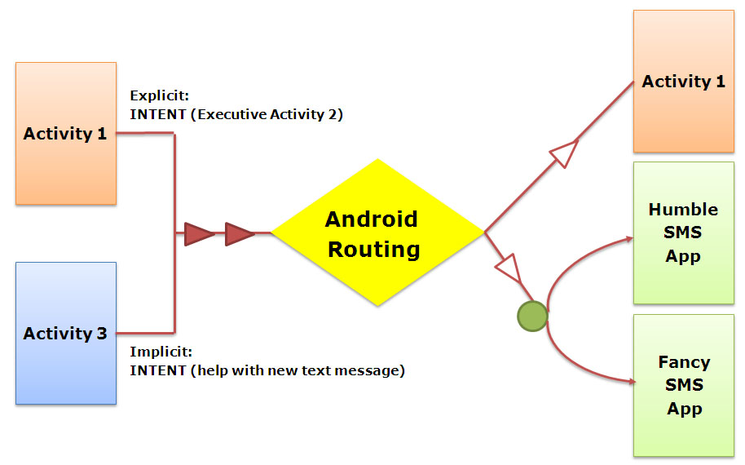
Internet Filters
Intent Resolution
Activity 3 has issue a generic request for help processing an incoming text‐message.

Slide 16
Internet Filters
Intent Resolution
Assume the user has installed a “Fancy SMS” application to (perhaps) replace the standard “HUMBLE SMS” app originally included in Android.

Slide 17
Internet Filters
Intent Resolution
Upon the arrival of the implicit Intent, Android will (somehow) tell the user: You have got a new text‐message. I have a FANCY and a HUMBLE SMS application – which one you want me to execute? Make it a default?

Slide 18
Internet Filters
Intent Resolution
Choosing candidates: For an activity to be eligible for execution it must:
Support the specified action
Support the indicated MIME type (if supplied)
Support all of the categories named in the intent.

Slide 19
Internet Filters
Example
The Manifest tells the application (FancySms) is able to intercept incoming SMS data using its SMSReceiver (potential alternative to the default SMS app.)
<?xml version="1.0" encoding="utf‐8"?>
<manifest xmlns:android="http://schemas.android.com/apk/res/android"
package="cis493.intentfilters" android:versionCode="1" android:versionName="1.0.0">
<uses‐permission android:name="android.permission.RECEIVE_SMS" />
<application android:icon="@drawable/icon" >
<activity android:name=".FancySms" >
<intent‐filter>
<action android:name="android.intent.action.MAIN" />

Slide 20
Internet Filters
Example
The Manifest tells the application (FancySms) is able to intercept incoming SMS data using its SMSReceiver (potential alternative to the default SMS app.)
<category android:name="android.intent.category.LAUNCHER" />
</intent‐filter>
</activity>
<receiver android:name="SMSReceiver" android:enabled="true" >
<intent‐filter>
<action android:name="android.provider.Telephony.SMS_RECEIVED" />
</intent‐filter>
</receiver></application></manifest>

Slide 21
Internet Filters
Comments On Example
The application consists of two components:
A common Activity called FancySms (acting as the main routine)
Abackground Service (BroadcastReceiver) called SMSService.
The clause below indicates the application is allowed to receive SMS
<uses‐permission android:name="android.permission.RECEIVE_SMS" />

Slide 22
Internet Filters
Comments On Example
The component SMS Service has the filter that triggers its execution whenever a new SMS is received
<intent‐filter>
android:name="android.provider.Telephony.SMS_RECEIVED" />
</intent‐filter>
Other applications with the same filter can be also called by Android when new SMS arrives (until a DEFAULT is chosen)

Slide 23
Internet Filters
Example: Intercepting Incoming SMS
<?xml version="1.0" encoding="utf-8"?>
<LinearLayout
android:id="@+id/mainLayout"
android:layout_width="fill_parent“ android:layout_height="fill_parent"
android:orientation="vertical"
xmlns:android="http://schemas.android.com/apk/res/android"
>
<TextView
android:layout_width="fill_parent" android:layout_height="wrap_content"
android:textSize="20px" android:textStyle="bold“ ndroid:background="#ff0000ff"
android:text="Intercepting SMS messages"
/>

Slide 24
Internet Filters
Example: Intercepting Incoming SMS
<ScrollView
android:id="@+id/myScroller1"
android:layout_width="fill_parent"
android:layout_height="fill_parent“
>
<TextView
android:id="@+id/theMessage"
android:layout_width="fill_parent" android:layout_height="fill_parent"
android:background="#ffffffff" android:padding="4px"
android:textSize="14px" android:textColor="#ff000000"
/>
</ScrollView>
</LinearLayout>

Slide 25
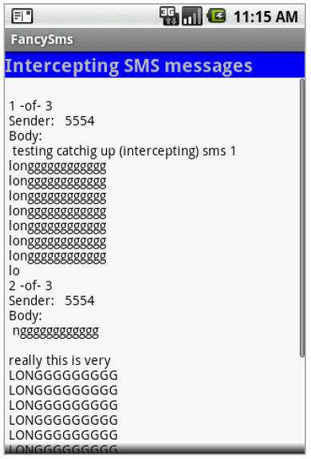
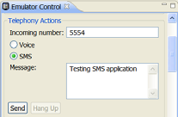
Internet Filters
Example: Intercepting Incoming SMS
Test the following application from the Eclipse’s DDMS perspective. Select “Emulator Control” > “Telephony Actions”. Set phone no. to 5554, type a message, click on Send. Alternatively you may start another emulator and send SMS to 5554

Slide 26
Internet Filters
Example: Intercepting Incoming SMS
// FancySms: main screen - displays intercepted SMS
package cis493.intentfilters;
import android.app.Activity;
import android.os.Bundle;
import android.widget.TextView;
public class FancySms extends Activity {
static TextView txtMsg;
@Override
public void onCreate(Bundle savedInstanceState) {
super.onCreate(savedInstanceState);
setContentView(R.layout.main);
txtMsg = (TextView)findViewById(R.id.theMessage);
}
}// class FancySms

Slide 27
Internet Filters
Example: Intercepting Incoming SMS
// SMSReceiver: listens to broadcasted SMS_RECEIVED signals
package cis493.intentfilters;
import android.content.BroadcastReceiver;
import android.content.Context;
import android.content.Intent;
import android.os.Bundle;
import android.telephony.gsm.SmsMessage;
import android.widget.Toast;
public class SMSReceiver extends BroadcastReceiver {
@Override
public void onReceive(Context context, Intent intent) {
// Android saves in a bundle the current text-message
// under name "pdus" and type: Object[]. Later we cast to
// SmsMessage[]. Jargon pdu stands for "protocol data unit”

Slide 28
Internet Filters
Example: Intercepting Incoming SMS
Bundle bundle = intent.getExtras();
Object messages[] = (Object[]) bundle.get("pdus");
SmsMessage smsMessage[] = new SmsMessage[messages.length];
// Note: long sms are broken and transmitted into various pieces
String msg = "";
int smsPieces = messages.length;
for (int n = 0; n < smsPieces; n++) {
smsMessage[n] = SmsMessage.createFromPdu((byte[]) messages[n]);
// grab all pieces of the intercepted sms
msg += "\n" + (n + 1) + " -of- " + smsPieces + "\n"
+ "Sender:\t" + smsMessage[n].getOriginatingAddress() + "\n"
+ "Body: \n " + smsMessage[n].getMessageBody();
}

Slide 29
Internet Filters
Example: Intercepting Incoming SMS
// show first part of intercepted (current) message
Toast toast = Toast.makeText(context, "FANCY >>> Received SMS: "
+ smsMessage[0].getMessageBody(), Toast.LENGTH_LONG);
toast.show();
cis493.intentfilters.FancySms.txtMsg.setText(msg);
}
}// class SMSReceiver

Slide 30
Internet Filters
Important Concepts
PDU
Is short for "Protocol Data Unit". This represents an amount of information delivered through a network layer.
VND
Virtual network data (today typically represents a business card with name, phone, email, etc). Originally registered as MIME vnd.abc intended for transmission of abc folk melodies in emails see:
http://www.iana.org/assignments/media‐types/text/vnd.abc

